Slide 1


Topic : AYUSH Startup Registration
Portal Domain : Health Team ID : T092 Team name : Zero Day Squad Team members : Zobiya Fatima(2303A51879) G. Spriha(2302A51850) A. Sushmitha(2303A51541) K. Bhavya Sri(2303A1863)

Slide 2

Objective
This System can Enable Startups to Register Efficiently.
This System will take Documents digitally, decreasing the regular workload.
It can facilitate Government Officials in Review and Approval.
It will Enhance Security and Compliance
Also Improves Communication and Transparency.
Ensures scalability and Integration.

Slide 3
Problem Statement
The AYUSH startup registration process is slow, inefficient, and lacks transparency, leading to delays and document mismanagement. Startups struggle with manual processes, security risks, and poor communication. A digital portal is needed to streamline registrations, enhance security, and provide real-time updates.
Challenges | Key Pain Points | Solutions
Lengthy Process | Time-Consuming Process | Digital application Submission & automation
Lack of Transparency | Uncertainty of Progress | Real-time status tracking
Manual Document Handling | Lost or misplaced Documents | Secure digital documents
Security Risks | Higer Risk of data breaches | Multi-factor authentication & Encryption
Poor Communication | Missed Updates | Email, SMS and push notifications

Slide 4
Current AYUSH Registration System Overview
User Authentication: | Basic login with limited security and role differentiation.
Application Submission & Document upload: | Manual forms without auto-save or edit options and document submission process with no version control, validation for AYUSH compliance.
Status Tracking: | No real-time tracking of application status. Users and officials have no visibility into the current progress
Data Management & Security: | The portal is not user-friendly, especially for non-tech-savvy users, making navigation and submission difficult.
User Experience (UX): | The portal is not user-friendly, especially for non-tech-savvy users, making navigation and submission difficult.
Limitations & Inefficiencies: | Streamlined Registration Process: Automate forms to reduce errors and speed up processing. Enhanced Data Security: Strengthen security to protect sensitive data from threats. Real-Time Application Tracking: Offer live updates to identify and resolve issues quickly.

Slide 5
Proposed system
Description:
This project involves creating a comprehensive AYUSH Startup Registration Portal designed to simplify and expedite the registration process for AYUSH startups. The portal will provide a user-friendly, secure, and scalable solution to manage a high volume of registrations.
Advantages:
Simplified Registration: Auto-fill, smart validation, and faster processing.
Enhanced Security: Data encryption and multi-factor authentication.
Real-Time Tracking: Instant updates and tracking for both applicants and officials.
Key Features:
Automated forms reduce errors and time.
Encrypted data protects sensitive information.
Dashboards offer live application tracking.

Slide 6
Workflow
Review & Approval -> Officials will review submissions & approve, reject or request changes.
​Upload -> Securely upload required documents for verification.
Step 02
Step 04
Step 01
Step 03
Step 05
​Registration -> Users create accounts by entering details.
Submission -> Complete and submit the online application with required details.
Tracking, Security & Support -> Users can track status, receive updates, & access support with strong data protection.

Slide 7
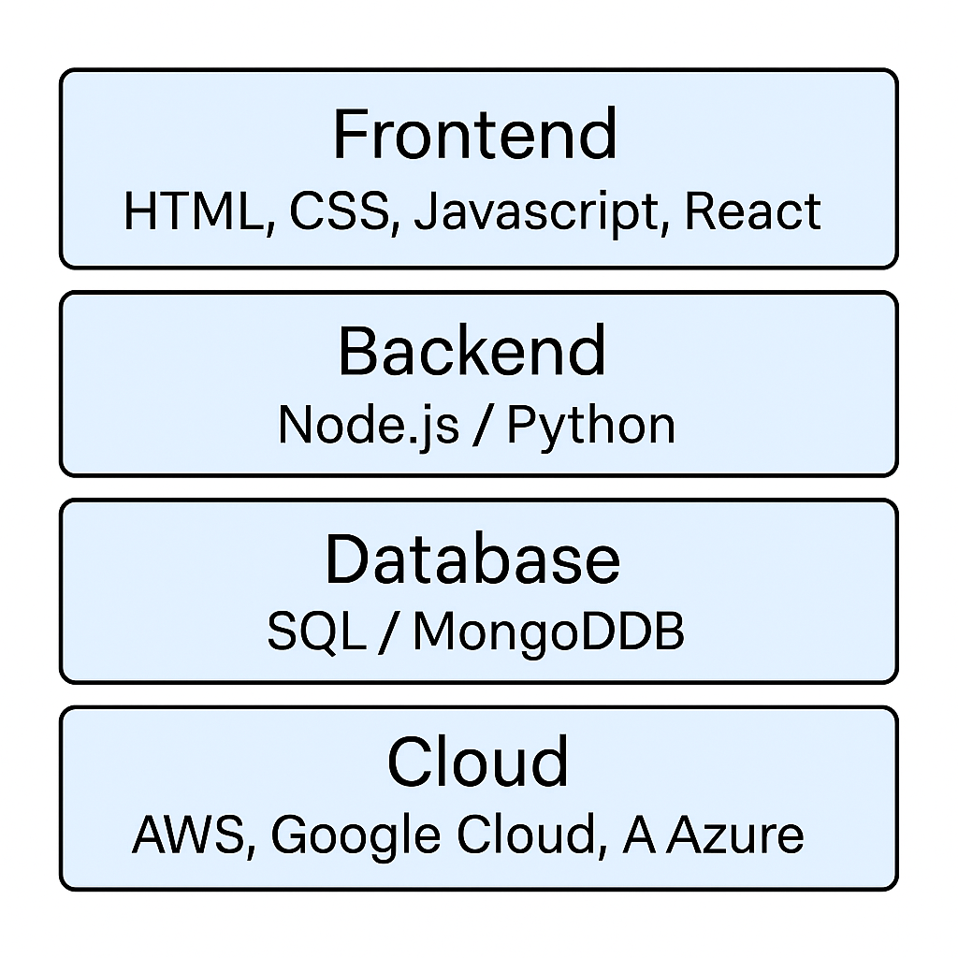
System Architecture
Tech Stack
Languages: HTML,CSS,JAVASCRIPT, Node/Python,
Database: Oracle
Database Security: Encryption, access control, backups.
Cloud service: AWS or Google Cloud
API’s: REST for data ,auth,documents,status
Final Output: Frontend -> Backend -> Database-> Cloud.

Slide 8
Conclusion & Future Scope
Key Takeaways
Developed a secure, scalable AYUSH Startup Registration Portal.
Streamlined and centralized registration process for enhanced user experience.
Impact and Benefits
Enhanced transparency and decreased delays in startup registration.
Increased facilitation of innovation and growth in AYUSH healthcare sector.
Potential Improvements
Incorporate AI-based support and multilingual capability.
Increase integration with biometric infrastructure and national databases.
Forward-Thinking Outlook
Potential to become a full-fledged AYUSH innovation and support ecosystem.
Potential for national reach through policy convergence and analytics.

